Slide 1



Module-1, Part-1
Design and Analysis of Algorithms
Topic Covered: Algorithm and Its Characteristics, Asymptotic Notations and Its Properties with Examples, Time Complexity Analysis, Performance Measurements of Algorithms, Comparisons of Different Classes

Slide 2


Syllabus
What, Why and How ?
Module 1- Algorithms, Performance Analysis, Recurrence Relations, Sorting Algorithms
Real Life Applications and Analysis of Different Sorting Algorithms, Recurrence and Tree Data Structure, Searching
Module 2- Greedy Techniques, Dynamic Programming, Back Tracking , Branch & Bounds, and Advance Data Structures
Understand some of the techniques such as Matrix Multiplications, Spanning Trees and Single Source Shortest Paths, Understand some of the applications of 0-1 Knapsacks, All Pair Shortest Paths, Graphs Coloring, N-Queen Problems
, RB Trees

Slide 3
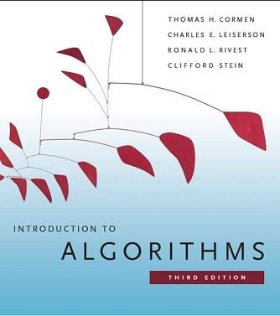
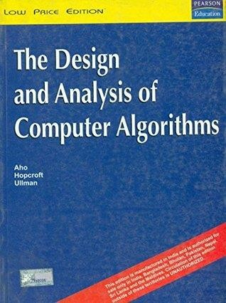
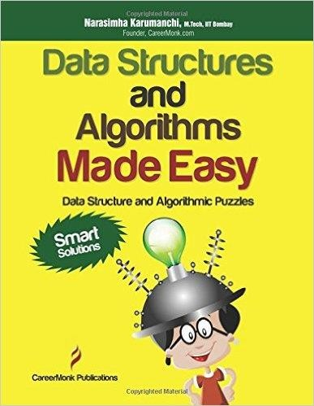



Books for Study

Slide 4



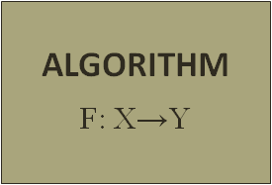
Algorithm
For Example
Making a Delicious Tea
Input
Output
Definition- Step by step procedures to solve a problem

Slide 5


BE NE FITS ?
WHY THIS C OUR SE & ITS

Slide 6





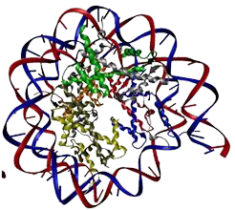


A L G O R I T H M S A R E F U N D A M E N T A L T O C S

Slide 7


Why Algorithms are Useful?
Once we find an algorithm for solving a problem, we do not need to re-discover it the next time we are faced with that problem.
All the knowledge required for solving the problem is present in the algorithm.
For your own use in the future, so that you don’t have spend the time for rethinking it
Makes it easy when explaining the process to others

Slide 8





A L G OR IT HMS A R E F UN & US E F UL
Competitive Exam
Interview

Slide 9

A l g o r i t h m a n d I t s C h a r a c t e r i s t i c s
Step by step procedures to solve a problem
Each instruction should be cleared and unambiguous
Zero or more input but at least one output
Must terminate within a finite amount of time

Slide 10
Difference Between Algorithm and Programme
Algorithm
An algorithm is a well-defined sequence of steps (written in Natural Language) to solve a given problem
Design Time
Domain Knowledge
Analyze
Independent from OS and H/W
Programme
A program is a set of instructions written in Programming Language (computer understandable language) to perform a certain task.
Program is an implementation of an algorithm
Knowledge of Programming Language
Testing
Dependent on OS and H/W

Slide 11


Example
5, 8, 2, 32, 12, 9, 11, 3
Algorithm of linear search :
Start from the leftmost element of arr[] and one by one compare x with each element of arr[].
Program for Linear Search :
int search(int arr[], int n, int x)
{
int i;
for (i = 0; i < n; i++) if (arr[i] == x) return i;
return -1;
}
If x matches with an element, return
the index.
If x doesn’t match with any of elements, return -1.

Slide 12



Pseudocode for Linear Search :
FUNCTION linearSearch(list, searchTerm):
FOR index FROM 0 -> length(list):
IF list[index] == searchTerm THEN RETURN index
ENDIF ENDLOOP
RETURN -1
END FUNCTION

Slide 13


It is one of the mathematical notation to represent an algorithm for a program.
It does not have a specific syntax like any of the programming languages and thus cannot be executed on a computer.
It is easier to read and understood by programmers who are familiar with different programming languages.
Pseudo Code
Pseudocode allows you to include several control structures such as While, If-then-else, Repeat-until, for and case, which is present in many high-level languages.
Note: Pseudocode is not an actual programming language.

Slide 14
Design and Analysis
Can I do better?
Algorithm Designer

Slide 15



Analysis of Algorithm
Given a particular problem of size n. The time required by any algorithm for solving, this problem is denoted by a function such as f(n).
Time complexity defines the total amount of time an algorithm needs to execute all its key statements and in generating the output. (running time)
Space: Amount to memory needed by the algorithm for its completion. (Space Complexity)
Good Algorithm
Solve a problem in less amount of time or space complexity or both.

Slide 16

Analysis of Algorithm
Continue...
Generally, we perform the following types of analysis −
For n input size
Worst-case − The maximum amount of time needed by the algorithm to complete a task (worst data or worst input size)
Best-case − The minimum amount of time needed by the algorithm to complete a task (best data or best input data)
Average case − The average amount of time needed by the algorithm to complete a task

Slide 17
Analysis of Algorithm
Continue...
Given two algorithms for a task, how do we find out which one is better?
A1
Algorithm 1
A2
Algorithm 2
Method-1
Implement both the algorithms and run the two programs on your computer for some inputs and see which one takes less time.
Task
Problems
It might be possible that for some inputs, first algorithm performs better than the second. And for some inputs second performs better.
Input 1: 3, 2, 7, 1, 8, 9 Input 2: 1, 2,3,7,8, 9
It might also be possible that for some inputs, first algorithm perform better on one machine and the second works better on other machine for some other inputs.

Slide 18



Analysis of Algorithm
Continue...
Apriori and Apostiari Analysis
Apriori analysis means analysis is performed prior to running it on a specific system.
We determine the time and space complexity of an algorithm by just looking at the algorithm rather than running it on a particular system with a different memory, processor, and compiler. (Theoretical Analysis)
Apostiari analysis of an algorithm means we perform analysis of an algorithm only after running it on a system. It directly depends on the system and changes from system to system. (Empirical Analysis)

Slide 19


Asymptotic Notation
(Algorithm's Growth Rate or Growth of Function)

Slide 20

Asymptotic Notation
(Algorithm's Growth Rate or Growth of Function)
The main idea of asymptotic analysis is to have a measure of the complexity of algorithms that don’t depend on machine-specific constants
It doesn’t require algorithms to be implemented and the time taken by programs to be compared.
It is used for very large value of n (data sets)
Different types of asymptotic notations are used to represent the complexity of an algorithm.
O − Big Oh (Tightly Upper Bound)
Ω − Big omega (Tightly Lower Bound)
θ − Big theta (both Lower and Upper Bound) o − Little Oh (Strictly Upper Bound)
ω − Little omega (Strictly Lower Bound)

Slide 21



Example of Asymptotic Analysis
(Best suitable for very large value of n or data sets)
~ 35 Lakh
Price: 35 Lakh
Price: 10,000/-
The simplest example is a function ƒ (n) = n²+3n, the term 3n becomes insignificant compared to n² when n is very large.
The function "ƒ (n) is said to be asymptotically equivalent to n² as n → ∞", and here is written symbolically as ƒ (n) ~ n².

Slide 22
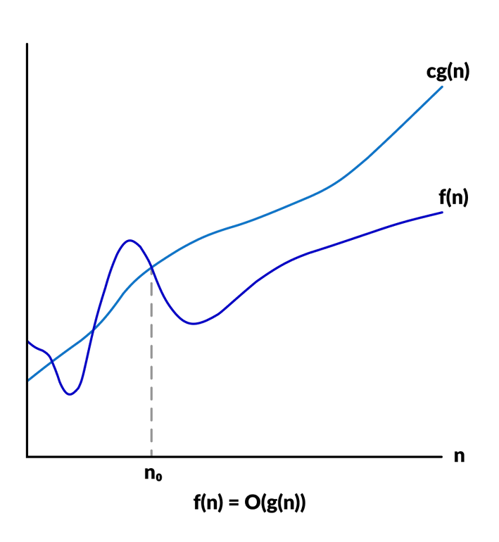
O − Big Oh Notation
Tightly Upper Bound of an Algorithm
Given a particular problem of size n. The time required by any algorithm for solving, this problem is denoted by a function such as f(n).
Lets assume, f(n) and g(n) are two functions
f(n) = O(g(n)) if there exists a positive integer n0
and a positive constant c, such that
f(n)≤c.g(n) ∀ n≥n0

Slide 23

Consider the following f(n) and g(n)... f(n) = 3n + 2 and g(n) = n
If we want to represent f(n) as O(g(n)) then it must satisfy f(n) <= C g(n) for all values of C > 0 and n>= n0,
f(n) <= C g(n)
⇒ 3n + 2 <= C n → 3n + 2 <= 5n for all value of n >1
The above condition is always TRUE for all values of C = 5 and n0 = 1.
By using Big - Oh notation
we can represent the time complexity as follows- f(n)= 3n + 2 = O(n)

Slide 24
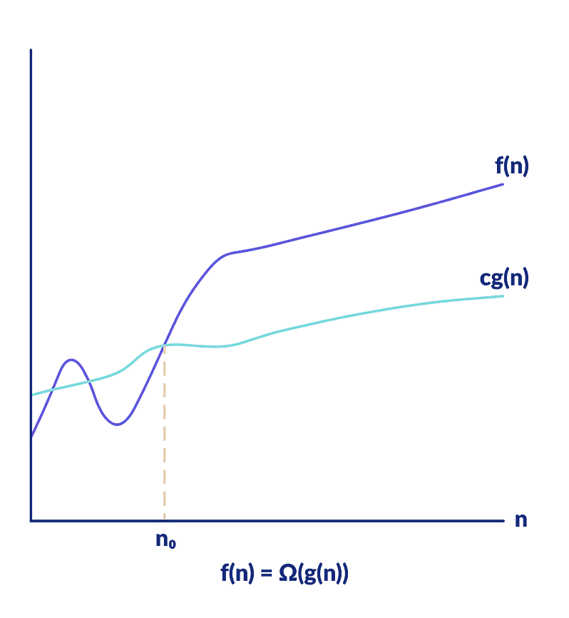
Ω − Big omega Notation
Tightly Lower bound of the running time of an algorithm.
For a given function f(n) and g(n), f(n) ≥ c.g(n), for n ≥ n0 ; c > 0 ; then
f(n) = Ω g(n)

Slide 25
Consider the following f(n) and g(n)...
f(n) = 3n + 2 and g(n) = n
If we want to represent f(n) as Ω(g(n)) then it must satisfy f(n) >= C g(n) for all values of C > 0 and n0>= 1
⇒ Cn <= 3n + 2 → 4n<= 3n+2 for c=4
The above condition is always TRUE for all values of C = 3 and n >= 1.
By using Big - Omega notation we can represent the time complexity as follows- f(n)= 3n + 2 = Ω (n)

Slide 26
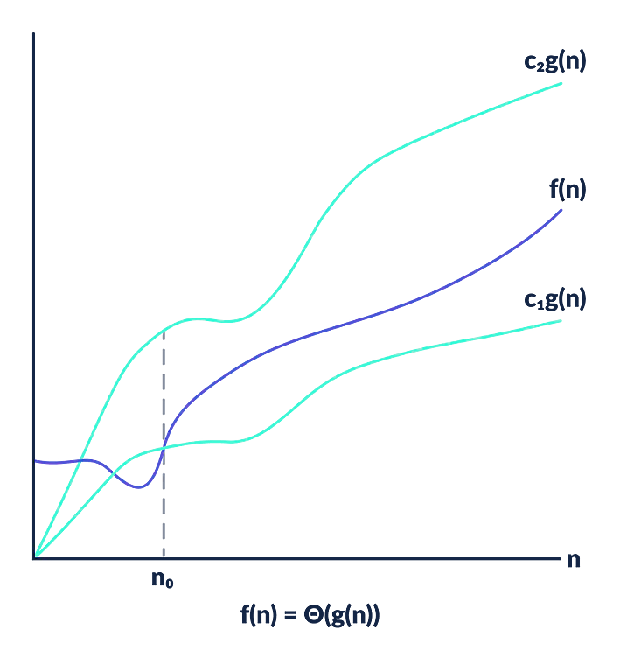
θ − Big theta Notation
Represents the upper and the lower bound of the running time of an algorithm
Used for analyzing the average-case complexity of an algorithm.
For a given function f(n) and g(n),
c1g(n) ≤ f(n) ≤ c2g(n), for n ≥ n₀ ; c > 0 ; n₀ ≥ 1
The Theta Notation is more precise than both the big-oh and Omega notation. The function f (n) = θ (g (n)) if g(n) is both an upper and lower bound.

Slide 27
f(n) = 3n + 2 and g(n) = n
If we want to represent f(n) as Θ(g(n)) then it must satisfy
C1 g(n) <= f(n) <= C2 g(n) for all values of C1 > 0, C2 > 0 and n0>= 1
C1 g(n) <= f(n) <= C2 g(n) ⇒ C1 n <= 3n + 2 <= C2 n → n <= 3n+2 <=5n
Above condition is always TRUE for all values of C1 = 1, C2 = 5 and n >= 1.
By using Big - Theta notation we can represent the time complexity as follows...
3n + 2 = Θ(n)

Slide 28
o − Little Oh & ω − Little omega
Little-o Notation (Strictly Upper Bound)
f(n) = n , g(n) = n²
f(n) < c.g(n) for c=2, n>=1 f(n)=o(g(n))
f(n) = o g(n) if, f(n) < c.g(n)
for some constant n₀ and c.
f(n) = n² , g(n) = n
f(n) > c.g(n)
f(n)=ω (g(n))
Little omega Notation (Strictly Lower Bound)
f(n) = ω g(n) if, f(n) > c.g(n)
for some constant n₀ and c.

Slide 29
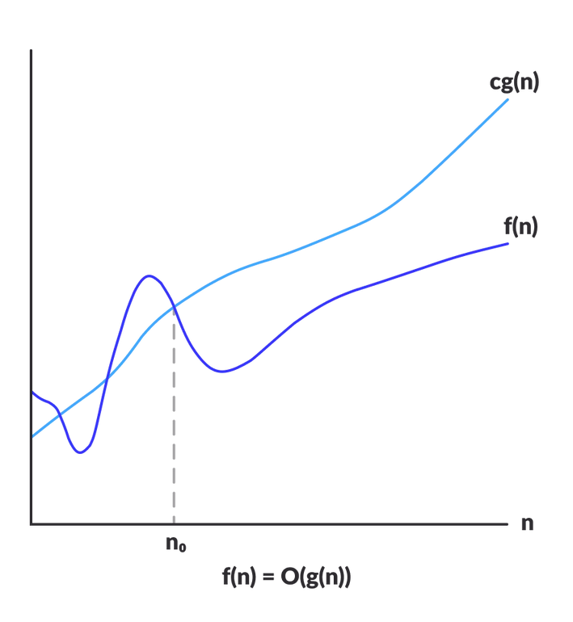
Example of Asymptotic Notation
O- Big Oh
f(n) = O(g(n)) if there exists a positive integer n ₀
and a positive
constant c, such that
f(n)≤c.g(n) ∀ n≥n₀
Example-1
As a simple illustrative example, we show that the function
f(n)= 2n² + 5n + 6
(for larger value of n, we ignore the smaller terms)
For n = 1000, 2n² will be 20,00,000 while 5n + 6 will be 5006 => 20,05,006 ~ 20,00,000
f(n)= 2n² + 5n + 6 asymptotically equivalent to O(n²)
For all n ≥ 1, it is the case that 2n² + 5n + 6 ≤ 2n² + 5n² + 6n² = 13n²
=> f(n)= 2n² + 5n + 6 ≤ 13n² → O(n²)
Hence, we can take с = 13 and n_{o} =1, and the definition is satisfied.

Slide 30

Example of Asymptotic Notation
O- Big Oh
f(n) = O(g(n)) if there exists a positive integer n0 and a
positive constant c, such that
f(n)≤c.g(n) ∀ n≥n₀
Example-2
Prove that 2n² = O(n³)
Proof
Assume that f(n) = 2n², and g(n) = n³ , f(n) = O(g(n)) ?
Now we have to find the existence of c and n₀ f(n) ≤ c.g(n) ➔ 2n² ≤ c.n³ ➔ 2 ≤ c.n
if we take, c = 1 and n₀= 2 OR c = 2 and n₀= 1 then
2n² ≤ c.n³ , Hence f(n) = O(g(n)), c = 1 and n₀= 2

Slide 31
Example of Asymptotic Notation
O- Big Oh
f(n) = O(g(n)) if there exists a positive integer n0 and a
positive constant c, such that
f(n)≤c.g(n) ∀ n≥n0
Example-3
Prove that 1000.n² + 1000.n = O(n²)
Proof
Assume that f(n) = 1000.n² + 1000.n, and g(n) = n²
We have to find existence of c and n₀ such that 0 ≤ f(n) ≤ c.g(n) ꓯ n ≥ n₀ 1000.n² + 1000.n ≤ c.n²
1000.n² + 1000n² = 2000.n² = c.n²
for c = 2000, 1000.n² + 1000.n ≤ 2000.n²
this is true for all value of n ≥ 1 , Hence f(n) = O(g(n)) for c = 2000 and n₀ = 1

Slide 32
Example of Asymptotic Notation
O- Big Oh
f(n) = O(g(n)) if there exists a positive integer n0 and a
positive constant c, such that
f(n)≤c.g(n) ∀ n≥n0
Example-4
Prove that n³ = O(n²) Proof
On contrary we assume that there exist some positive constants c and n₀ such that
0 ≤ n³ ≤ c.n² ꓯ n ≥ n₀
=> n³ ≤ c.n² → n ≤ c
Since c is any fixed number and n is any arbitrary constant, therefore n ≤ c is not possible in general.
Hence our supposition is wrong and n³ ≤ c.n², for n ≥ n₀ is not true for any combination of c and n₀. Hence, n³ = O(n²) does not hold

Slide 33
Example of Asymptotic Analysis
O- Big Oh
f(n) = O(g(n)) if there exists a positive integer n0 and a
positive constant c, such that
f(n)≤c.g(n) ∀ n≥n0
Example-5
Find an Upper bound for f(n) =n⁴ + 1000n³+ 5000n
n⁴ + 1000n³+ 5000n <= 2*n⁴
for all n>= 10
F(n)= n⁴ + 1000n³+ 5000n = O(n⁴) with c =2 and n_{o}=10
F(n) = n⁴ + 1000n³+ 5000n >= n⁴
for all n>= 1 → F(n)= Ω (n⁴) with C=1 and n_{o}=1

Slide 34

Assessment
Question -1
F(n) = 1000 n² + 5n³ + 600000n, What is the Order of Function ?
Answer : f(n)= O(n³) Question -2
F(n) = n⁵ + 500n³ + 5000n² + 99999999*9999 What is the Order of Function ?
Answer : f(n)= O(n⁵)
Question -3
F(n) = n + 500*n + 5000*n + 50,00,000*n What is the Order of Function ?
Answer : f(n)= O(n)

Slide 35

Properties of Asymptotic Notation
Reflexivity
Symmetry
Transitivity
Transpose Symmetry
General Properties

Slide 36

Properties of Asymptotic Notation
1. Reflexive Properties
If f(n) is given then f(n) = O(f(n)) Example: If f(n) = n³ ⇒ O(n³) Similarly,
f(n) = Ω(f(n)) or f(n) = Θ(f(n))

Slide 37

Properties of Asymptotic Notation
2. Symmetry Properties
(Valid only for Theta Notation)
If f(n) = Θ(g(n)), then g(n) = Θ(f(n))
Example
If f(n) = n² and g(n) = n²
then f(n) = Θ(n²) and g(n) = Θ(n²)

Slide 38
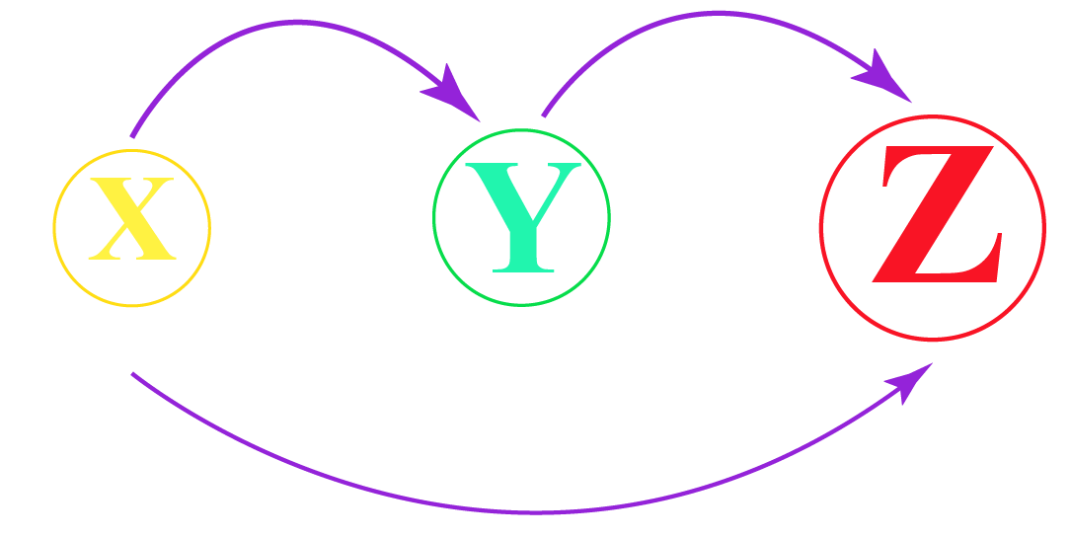
Properties of Asymptotic Notation
3. Transitive Properties (for all notations)
f(n) = O(g(n)) and g(n) = O(h(n)) then
⇒ f(n) = O(h(n))
Example
If f(n) = n, g(n) = n² and h(n) = n³
n<n²<n³
⇒ n is O(n²) and n² is O(n³) then n is O(n³)

Slide 39
Properties of Asymptotic Notation
4. Transpose Symmetry (for Big Oh and Omega notation only)
If f(n) = O(g(n)) then g(n) = Ω(f(n))
Example
If f(n) = n and g(n) = n²
then n is O(n²) and n² is Ω(n)

Slide 40

Properties of Asymptotic Notation
General Properties
A. If f(n) = O(g(n)) or Ω (g(n) or Θ (g(n)) Then a* f(n) = O(g(n)) or Ω (g(n) or Θ (g(n))
Example: f(n) = 2n² + 5 = O(n²)
if a =5, → a* f(n) → 10n²+ 25 = O(n²)
* Valid for all notations

Slide 41
Properties of Asymptotic Notation
5. General Properties
B. If f(n) = O(g(n)) and f(n)= Ω (g(n) Then f(n) = Θ (g(n))
Example: f(n) = n² and g(n) = n² g(n)<=f(n)<=g(n)

Slide 42
Properties of Asymptotic Notation
5. General Properties
C. If f(n) = O(g(n)) and d(n)= O (e(n)) Then f(n) + d(n) = O(max (g(n), e(n)))
Example: f(n) = n = O(n) and d(n) = n² =O(n²) f(n) + d(n) = n+ n² = O(n²)

Slide 43
Properties of Asymptotic Notation
5. General Properties
D. If f(n) = O(g(n)) and d(n)= O (e(n)) Then f(n) * d(n) = O( (g(n)* e(n)))
Example: f(n) = n = O(n) and d(n) = n² =O(n²) f(n) * d(n) = n* n² = n³ = O(n³)

Slide 44

Practice Examples
Example 1- F(n) = n³ D(n) = n⁴ E(n) = n⁶
T(n)= F(n) + D(n) + E(n)
O(T(n))= ?
O(T(n))= n⁶
Example 2- F(n) = 3n²*n³ + n*n² + 20n²*n² + 2n²
O(f(n))= ?
O(f(n))= n⁵
Example 3- F(n) = 3n³ + n^{3.5} + 10n⁴ + 2n²
O(f(n))= ?
O(f(n))= n⁴

Slide 45
Practice Examples
Example 4- F(n) = n² + n⁴ D(n) = n²
T(n)= F(n) * D(n)
O(T(n))= ?
O(T(n))= n⁶
Example 5- F(n) = 3n⁴ + 2n²
If T(n) = 10,000 * F(n), then O(T(n))= ?
O(T(n))= n⁴

Slide 46


Example of Worst-Average-Best Case Analysis of Algorithms

Slide 47



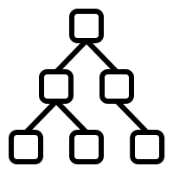
Worst-Average-Best Case Analysis of Algorithms
01 Linear Search
02 Binary Search Tree

Slide 48

1. Linear Search
8
3 2
4 5 7
1
6
Algorithm of linear search-
Step 1- Start from the leftmost element of arr[] and one by one compare x with each element of arr[].
Step 2- If x matches with an element, return the index. Step 3- If x doesn’t match with any of the elements,
return -1.
Key Element = 4
Key Element = 9
~
Total Number of Comparision = 5
Total Number of Comparision = 8

Slide 49
Linear Search
8
3 2
6
1
4 5 7
Best Case
Searching the key element present at the first index of a list
Best Case Time Complexity
Key Element = 8 Total Number of Comparision = 1
b(n) = 1 = Constant b(n) = O(1)

Slide 50
Linear Search
8
3 2
6
1
4 5 7
Worst Case
Searching the key element present at last index of a list
Worst Case Time Complexity
Key Element = 7 Total Number of Comparision = 8
w(n) = n w(n) = O(n)
for n elements

Slide 51

Linear Search
8
3 2
6
1
4 5 7
Average Case
All possible case time divided by number of cases
Average Case Time Complexity
Very difficult to analyze
Average Time= 1+2+3+...n/2 = n(n+1)/2n = n+1/2
A(n) = O(n)

Slide 52

Apply Asymptotic Notations in the Case Analysis
For Liner Search
Worst Case Time w(n) = n (Representing Linear Class)
For Best Case,
Can we write
b(n)= O(1)
b(n)= Omega(1)
b(n)= Theta(1)
Can we write
w(n)= O(n)
w(n)= Omega(n) w(n)= Theta(n) _{Yes}
There is no standard fixed asymptotic notations to represent the worst-case or best case or average case analysis of
algorithms

Slide 53

To ease of understanding
Worst Case Timing can be represented as Upper Bound but vice versa is not true
In this subject
(depend on the data structure used)
we will use Big O to represent the Worst-Case Timing
Big Omega for the Best Case
Theta for the Average case

Slide 54
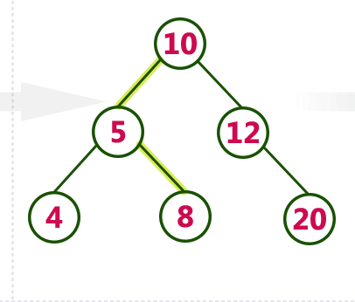
2. Binary Search Tree
Searching a 8 number element in a tree, requires 3 comparisions
h
For n elements, h= logn

Slide 55
2. Binary Search Tree
Best Case
Searching the key element present
at the root of the tree
Best Case Time Complexity
Key Element = 10
Total Number of Comparision = 1
b(n) = 1 = Constant b(n) = O(1)

Slide 56
2. Binary Search Tree
Worst Case
Searching the key element present at leaf node of a tree
Worst Case Time Complexity
Key Element = 8
Total Number of Comparision = 3
i.e. log 8 =3
for n elements
w(n) = logn w(n) = O(logn)

Slide 57
2. Binary Search Tree
20
logn
12
10
n
8
5
Skewed Binary Search Tree
Worst Case Time Complexity
4
Key Element = 4
for n elements
Total Number of Comparision = 6,
w(n) = n w(n) = O(n)
Time = 6 units

Slide 58
2. Binary Search Tree
20
logn
12
10
n
8
5
Skewed Binary Search Tree
Worst Case Time Complexity
4
minimum worst case timing w(n) = O(logn) for balanced binary tree
maximum worst case timing w(n) = O(n) for skewed binary tree

Slide 59
Analysis and Performance Measurements of Algorithms

Slide 60

Write an Algorithm to Swap two numbers
a=5, b=10
temp=a; a=b; b=temp;
Algorithm Swap (a, b)
{
temp=a; a=b; b=temp;
}
Algorithm Swap (a, b) begin
temp:=a; or temp<-a; a:=b; or a<-b; b:=temp; or b<- temp; end
Note: Any one method discussed above or even different methods can be used to write an algorithm.

Slide 61

How to analyze the algorithm
Algorithm Swap (a, b)
{
temp=a; a=b;
b=temp;
}
1 unit of time
1 unit of time 1 unit of time
Total= 3 unit of time
Time Complexity= f(n)= constant = O(1)
*Assume that every statement take one unit of time for execution
For Example
if a statement is defined as : X= 3*a + 5*b +6 , If we convert into Machine Code, it will have 2 multiplications, 2 addition and one assignment but we will ignore the machine analysis and simple assume that each statement takes 1 unit of time

Slide 62
How to analyze the algorithm
Space Complexity
Algorithm Swap (a, b)
{
temp=a; a=b; b=temp;
}
Total Variable
a b
temp
1 word
1 word
1 word
Total= 3 words
Space Complexity= s(n)= constant = O(1)

Slide 63







Frequency Count Methods (Loop)
(to analyze the algorithm)
Sum of n number
Algorithm Sum (A, n)
{
S=0;
n=5
A = 6
0
i=0 i=1 i=2 i=3
i=4 i=5
4
1
3 8 1
2 3 4
1
for ( i=0; i<n; i++)
{
S= S + A[i];
}
return S;
n+1
i=0 -> 1
i++ -> n i<n -> n+1
n
1
i<n
condition checked 6 times
i++, i has changed 5
times
}
f(n) = 2n+3 = O(n)

Slide 64

Frequency Count Method (Nested Loop)
(to analyze the algorithm)
Sum of two Matrices of size n*n
Algorithm Sum (A, B, n)
{
for ( i=0; i<n; i++)
{
for ( j=0; j<n; j++)
{
C[i, j ]= A [i, j] + B[i, j];
}
Space Complexity
A ----->n * n
B------>n*n
C------>n*n
i------>1
j------>1
n------>1
n+1
n*
n *
(n+1)
n
S(n) = 3n²+3 = O(n²)
}
} f(n) = n+1 + n* (n+1) + n* n = 2n² + 2n + 1= O(n²)

Slide 65

Frequency Count Method (Nested Loop)
(to analyze the algorithm)
Multiplication of two Matrices of size n*n
Algorithm Sum (A, B, n)
{
for ( i=0; i<n; i++)
{
for ( j=0; j<n; j++)
{
C[i,j]=0;
for ( k=0; k<n; k++)
{
C[i, j ]= C[i,j] + A [i, k] * B[k, j];
}
}
Space Complexity
A ----->n * n
B------>n*n
C------>n*n
i------>1
j------>1
k------>1
n------>1
S(n) = 3n²+4 = O(n²)
n+1
n* (n+1) n* n
n* n*(n+1)
n* n* n
}
f(n) = n+1 + n* (n+1) + n* n + n* n*(n+1) + n*n*n
= 2n³ + 3n² + 2n+ 1= O(n³)
}

Slide 66

Some Examples of For Loop
for ( i=0; i<n; i++)
{
statement;
}
f(n) = O(n)
for ( i=n; i>0; i--)
{
statement;
}
for ( i=1; i<n; i=i+2)
{
statement;
}
f(n) = O(n)
f(n) = n/2= O(n)

Slide 67

Some Examples of For Loop
i 1
1*2=2
2*2=2²
2*2*2=2³
2*2*2*2=2⁴
.
.
2*2*2*2...k = 2^{K}
for ( i=1; i<n; i=i*2)
{
statement;
}
Assume that 2^{K}>=n (stopping condition) take log both side → log₂ (2^{K}) = log (n)
k =log₂n → O(log₂n)

Slide 68
Some Examples of For Loop
i n
n/2=n/2 n/2*2=n/2² n/2*2*2=n/2³
n/2*2*2*2=n/2⁴.
for ( i=n; i>1; i=i/2)
{
statement;
}
.
.
n/2*2*2*2...k = n/2^{K}
Assume that n/2^{K}=1 (stopping condition) n=2^{k} → take log₂ both side
log₂(n) = log₂(2^{k}) → k =log₂n → O(log₂n)

Slide 69
Some Examples of For Loop
i
1
2
3
4
5
.
.
k
p
0+1
1+2
1+2+3
1+2+3+4
1+2+3+4+5
.
. 1+2+3+4+5.....+k
p=0;
for ( i=1; p<n; i++)
{
p=p+i;
}
Assume that p=n (stopping condition)
--> p=1+2+3+4+5+...+k
--> k(k+1)/2 = n
(k²+k)/2 = n ---> k² + k = 2* n --> k²=n k=sqrt (n), k = O(sqrt(n))

Slide 70
Examples of independent loops
for ( i=0; i<n; i++)
{
statement;
}
n
for ( i=0; i<n; i++)
{
statement;
}
f(n) = n+n+n
=3n
n
f(n)= O(n)
for ( i=0; i<n; i++)
{
statement;
}
n

Slide 71
Commonly used Logarithm and Summations
Logarithms Arithmetic Series
log x^{y} = ylogx
log xy = log x + log y
log^{k}n = (logn)^{k}
log logn = log (logn)
log(x/y)= logx –log y
_{a} log_{b}^{x} _{= x}log_{b}a
log_{b}x = log _{a}x /log_{a}b
f(n) = 1+2+3+4+5…+n = n(n+1)/2
Geometric Series
f(n) = 1+2 + 2²+ 2³+ …+2^{n} = 2^{n+1} -1/n-1
Harmonic Series
f(n) = 1 + 1/2 + 1/3 +…..+1/n = logn

Slide 72
Type and Comparison of Order of Function of Classes
(Valid for larger values of n)
O(1) < O(logn) < O(√n)
Log₂n
< O(n) < O(nlogn) < O(n²) < O(n³) < O(2^{n}) < O(10^{n}) < O(n^{n})
_{n}2 _{n}3
1 1
4 8
16 64
64 512
₂n
2
4
16
256
_{n}n
1
4
256
1,67,77,216
n
1
2
4
8
n=1 n=2
n=4 n=8
n=10
0
1
2
3
3.2
10
100
1000
1024
₁₀10

Slide 73
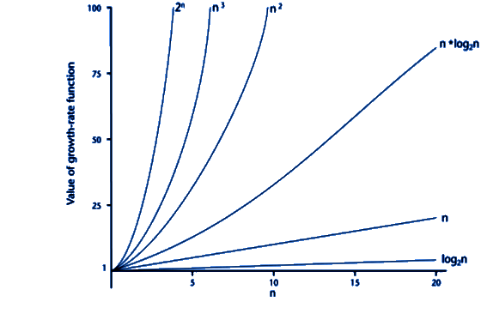
Comparison of Order of Growths of Functions

Slide 74
Comparison of Functions
1. Substitution Method
f(n)= n²logn g(n)= n(logn)¹⁰
How will you solve the comparison?
_{n}2
_{n}3
n=2
n=3
n=4 n=5
4 | 8
9 | 27
16 | 64
25 | 125

Slide 75
_{n}2
Comparison of Functions
2. Log Method (Apply Log at both side)
_{n}3
Log n²
log n³
Using this formula: log x^{y} = ylogx
2Log n
<
3log n

Slide 76

Some Logarithms Formula
log x^{y} = ylogx
log xy = log x + log y
log^{k}n = (logn)^{k}
log logn = log (logn)
5. log(x/y)= logx –log y
x
a
6. a = x b
log
b
log
log_{b}x = log _{a}x /log_{a}b
if a^{b}=n then b= log_{a}n

Slide 77

Examples of Comparison of Functions
f(n)= n²logn
g(n)= n(logn)¹⁰
Apply Log at both side
log (n²logn)
log(n(logn)¹⁰)
Using this formula log xy = log x + log y
log (n²) + log(logn)
log(n)+ log(logn)¹⁰
Using this formula: log x^{y} = ylogx
2logn + loglogn
>
logn+ 10log(logn)
_{n= 2} 1000
Logn = Log 2 ¹⁰⁰⁰ =1000
f(n)> g(n)
log(logn)= Log log 2¹⁰⁰⁰ = log 1000 ~= log 2¹⁰ =10
Logn>loglogn for all value of n

Slide 78
Examples of Comparison of Functions
_{g(n)= 2}√n * (logn)
f(n)= 3n^{√n}
Using this log x^{y} = ylogx
_{3n}√n
₂ logn^{√n}
Using this formula
x
a
a b = x b
_{3n}√n
_{(n}√n₎log2
log log
_{3n}√n
_{n}√n
f(n)>g(n)

Slide 79
Next Module
Designing Techniques of Algorithms, Recurrence Relations, Designing and Analysis of Sorting Algorithms (Insertion Sort, Shell Sort, Quick Sort, Merge Sort, Heap Sort, Liner Sorting (Count Sort)), Red Black Trees, and Searching

Slide 80

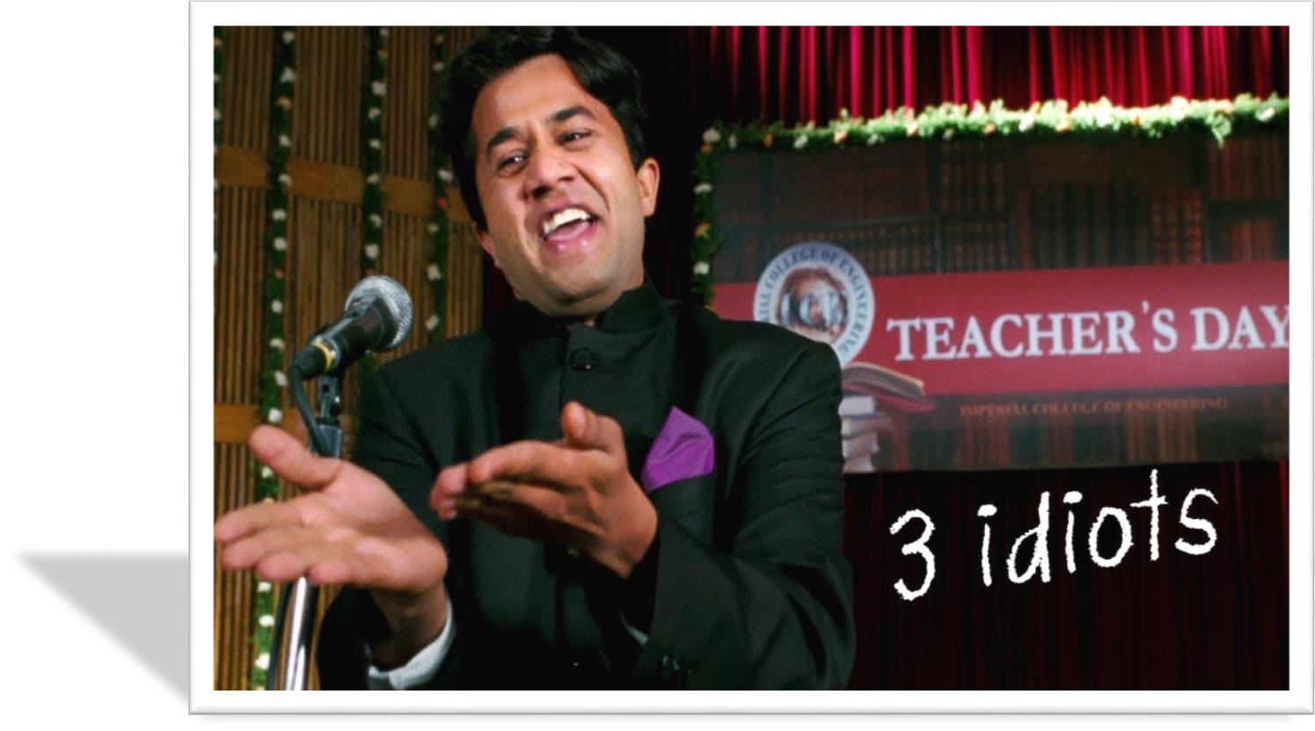

Choose Wisely
Happy Learning!

